Slide 1


Northlands and Sunfield City School
Grade 3– Health Education
Unit 3 – Movement and safe practices
Road Safety
Week 6 prepared by Miss Amrine

Slide 2
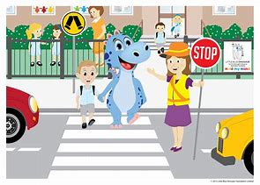
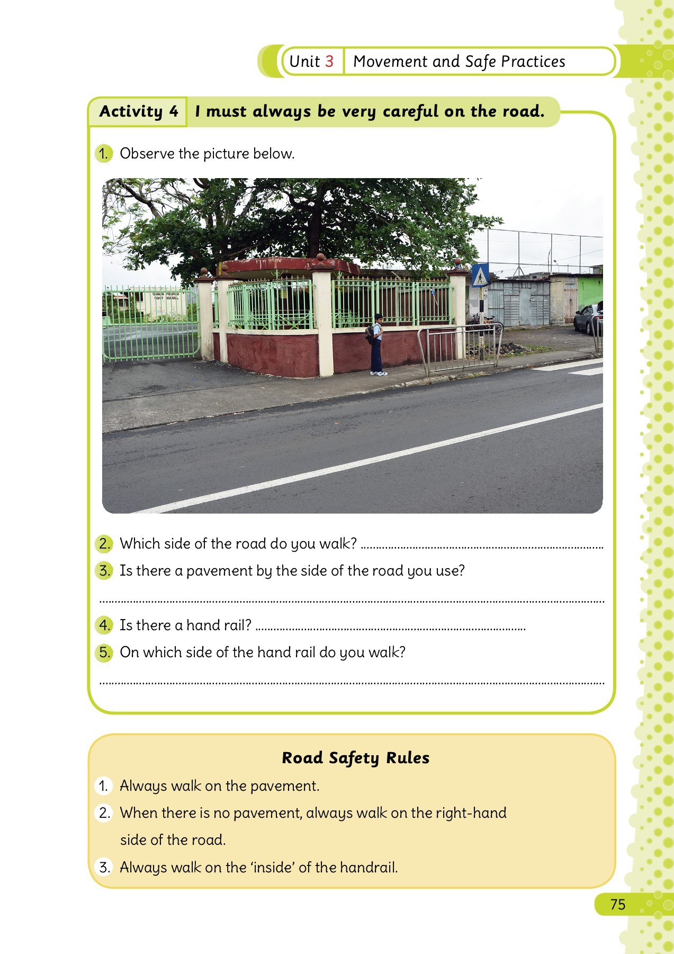
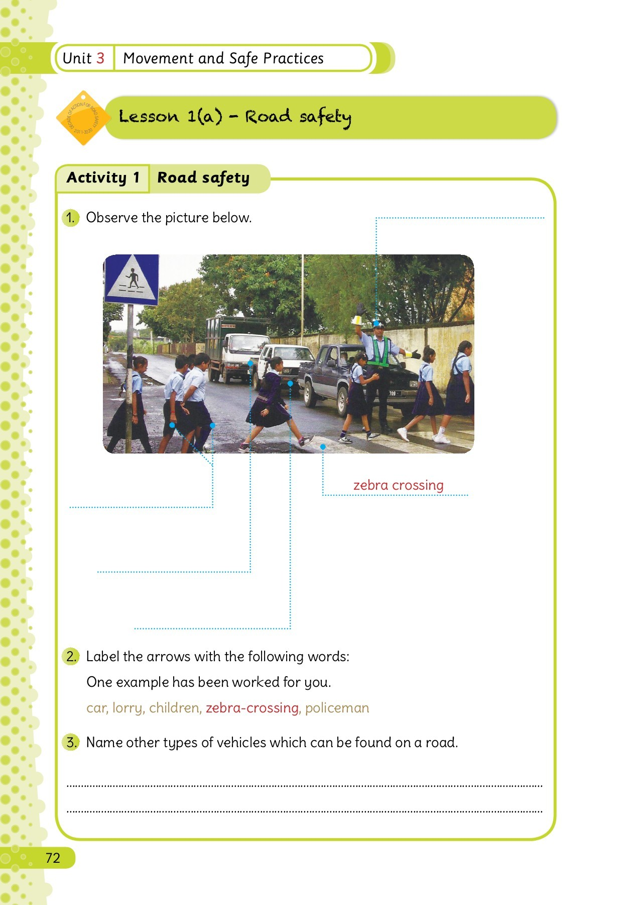
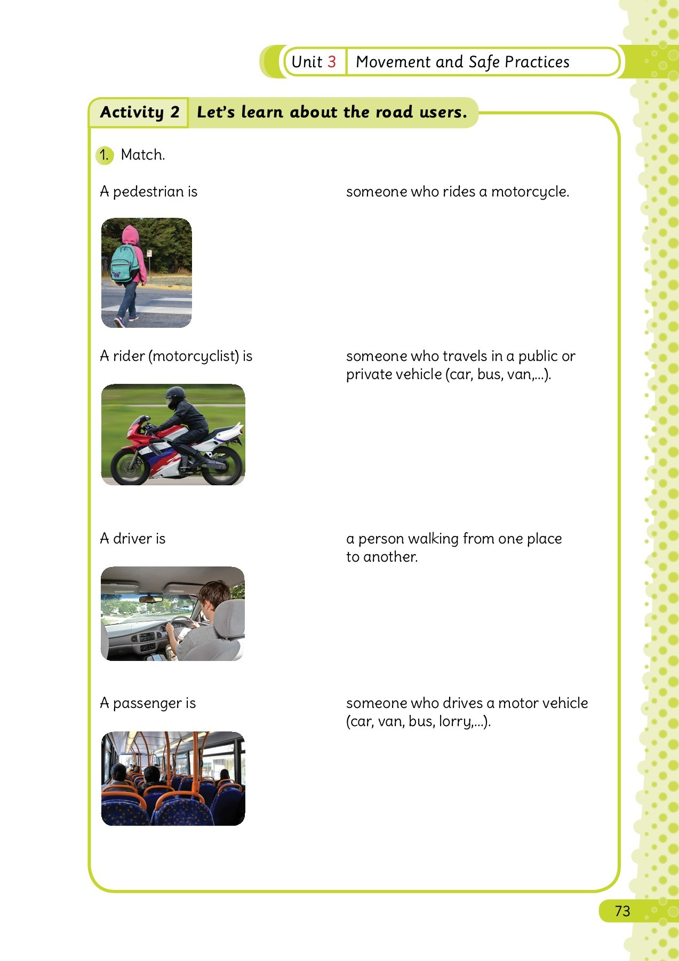
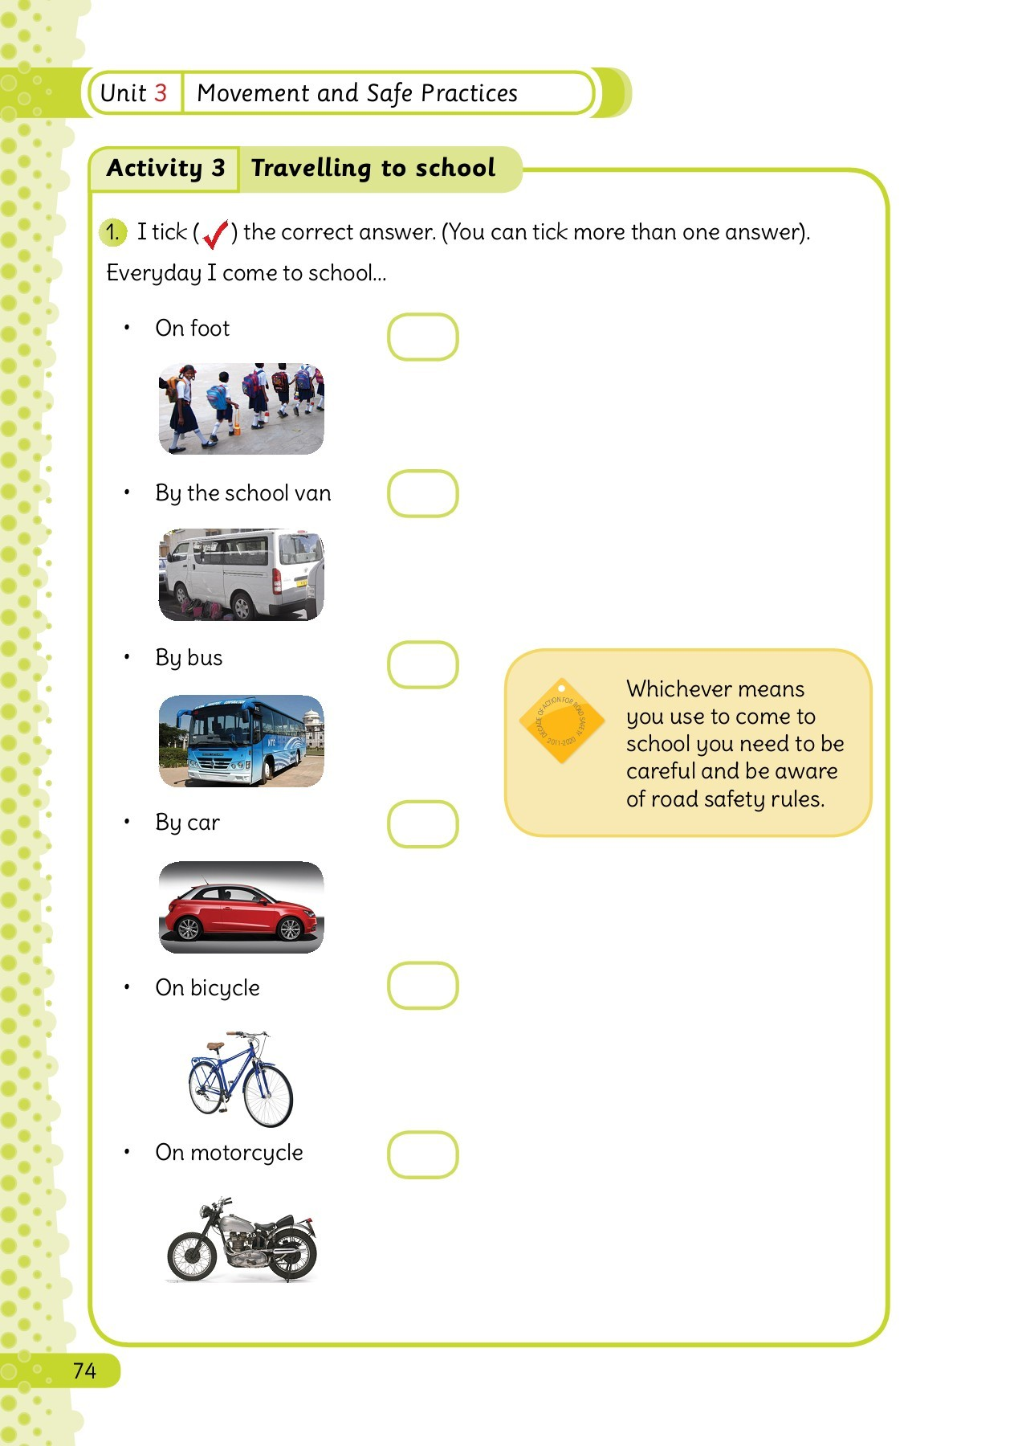
Road safety

Slide 3

