Slide 1


Northlands and Sunfield City School
Grade 2– Health Education
Meals
Week 6 prepared by Miss Amrine

Slide 2

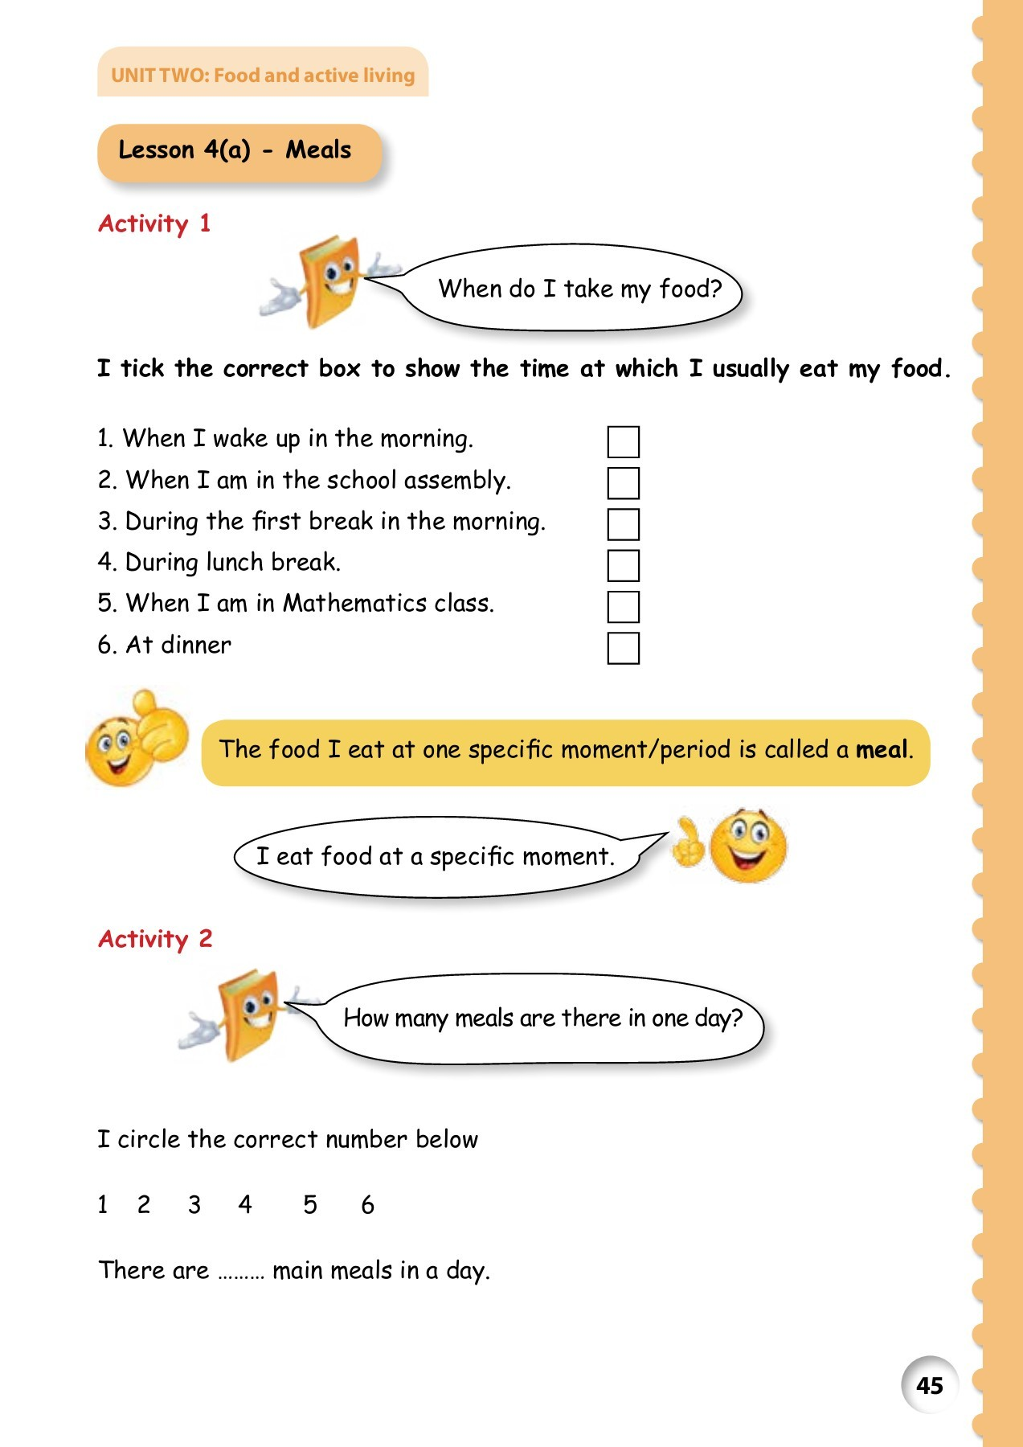
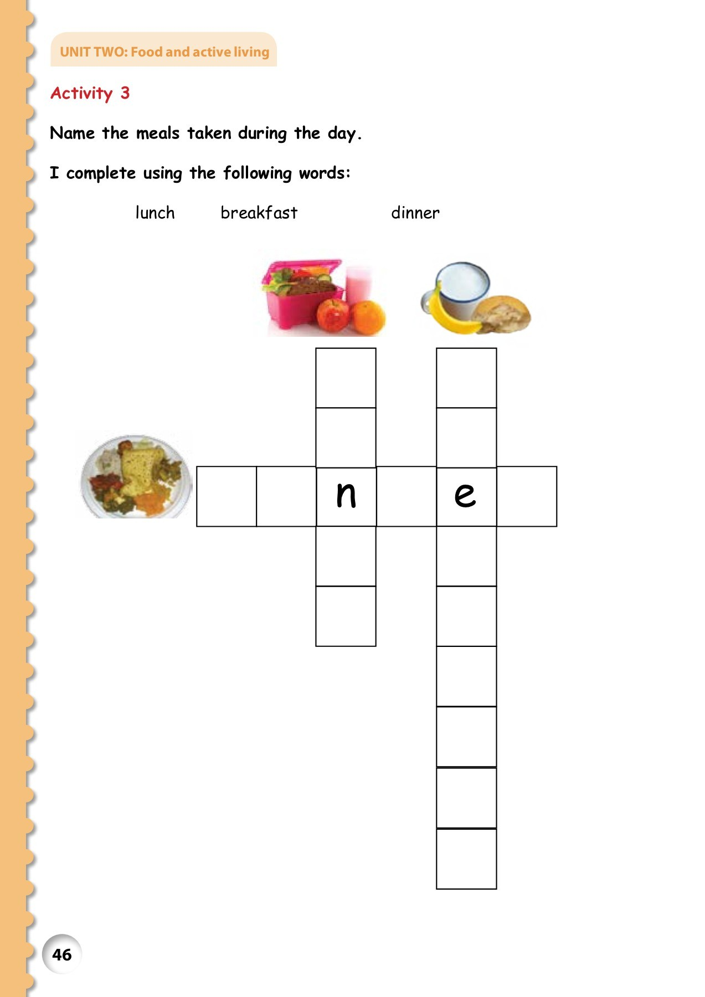
Meals

Slide 3

