Slide 1


Northlands and Sunfield City School
Grade 1– Mathematics – TIME pg 50-56
Week 6 prepared by Miss Sweetie
OBJECTIVE:
Recognise and identify the numerals 6 , 7 and 8
Recognise and identify the number names six , seven and eight
Read , write and spell the numerals and its names

Slide 2
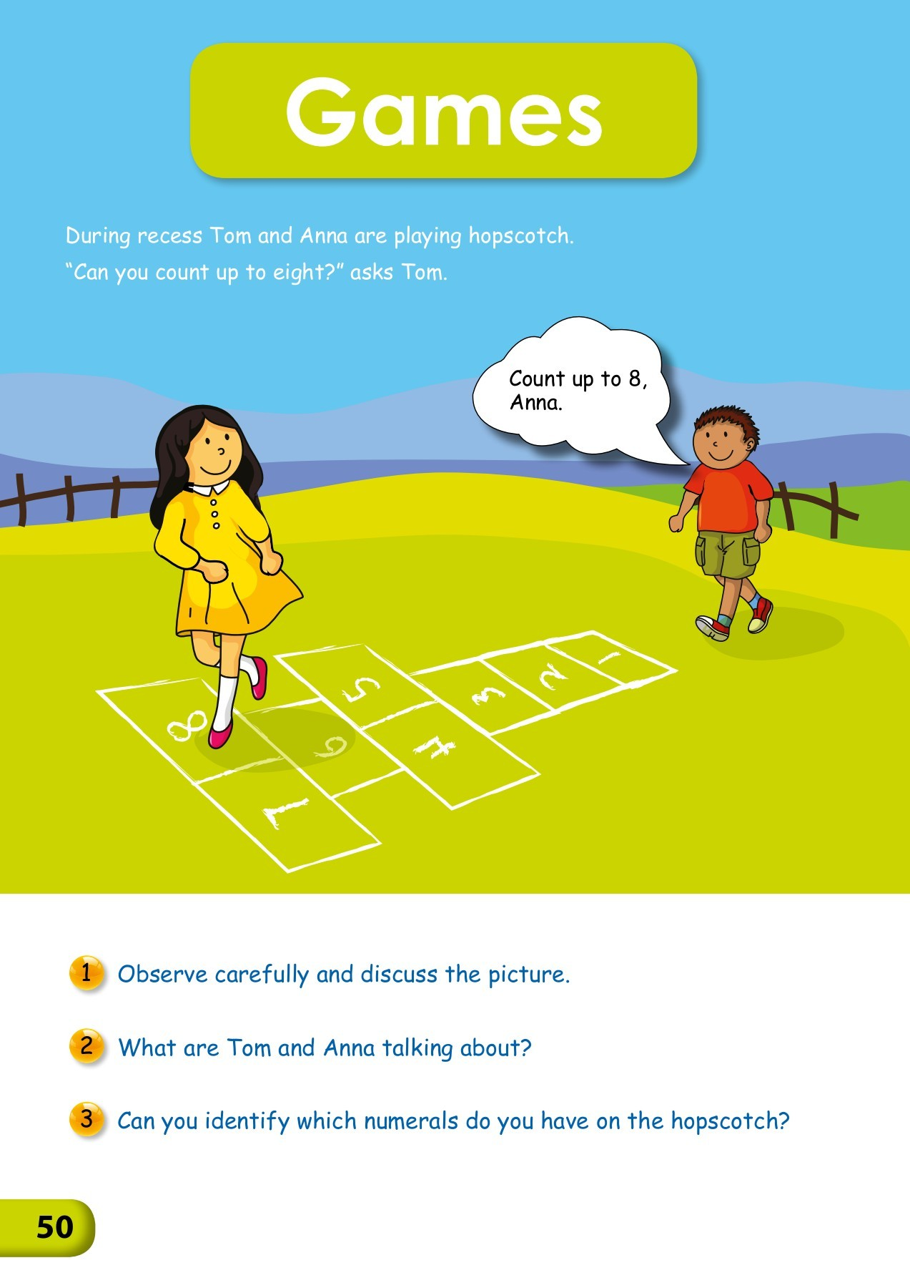
‘hopscotch game’ picture discussion on page 50
WHY HOPSCOTCH MATTERS
HOPPING = MIDLINE DEVELOPMENT.
DON'T STEP ON THE LINE = BODY CONTROL.
STOP & START = BODY RHYTHM.
LEAPING = MUSCLE STRENGTH.
ONE-FOOTEDNESS = BALANCE.
SPACES = SPATIAL AWARENESS.
PITCHING PEBBLES = EYE/HAND COORDINATION.
PICKING UP YOUR PEBBLE = FINE MOTOR CONTROL.

Slide 3
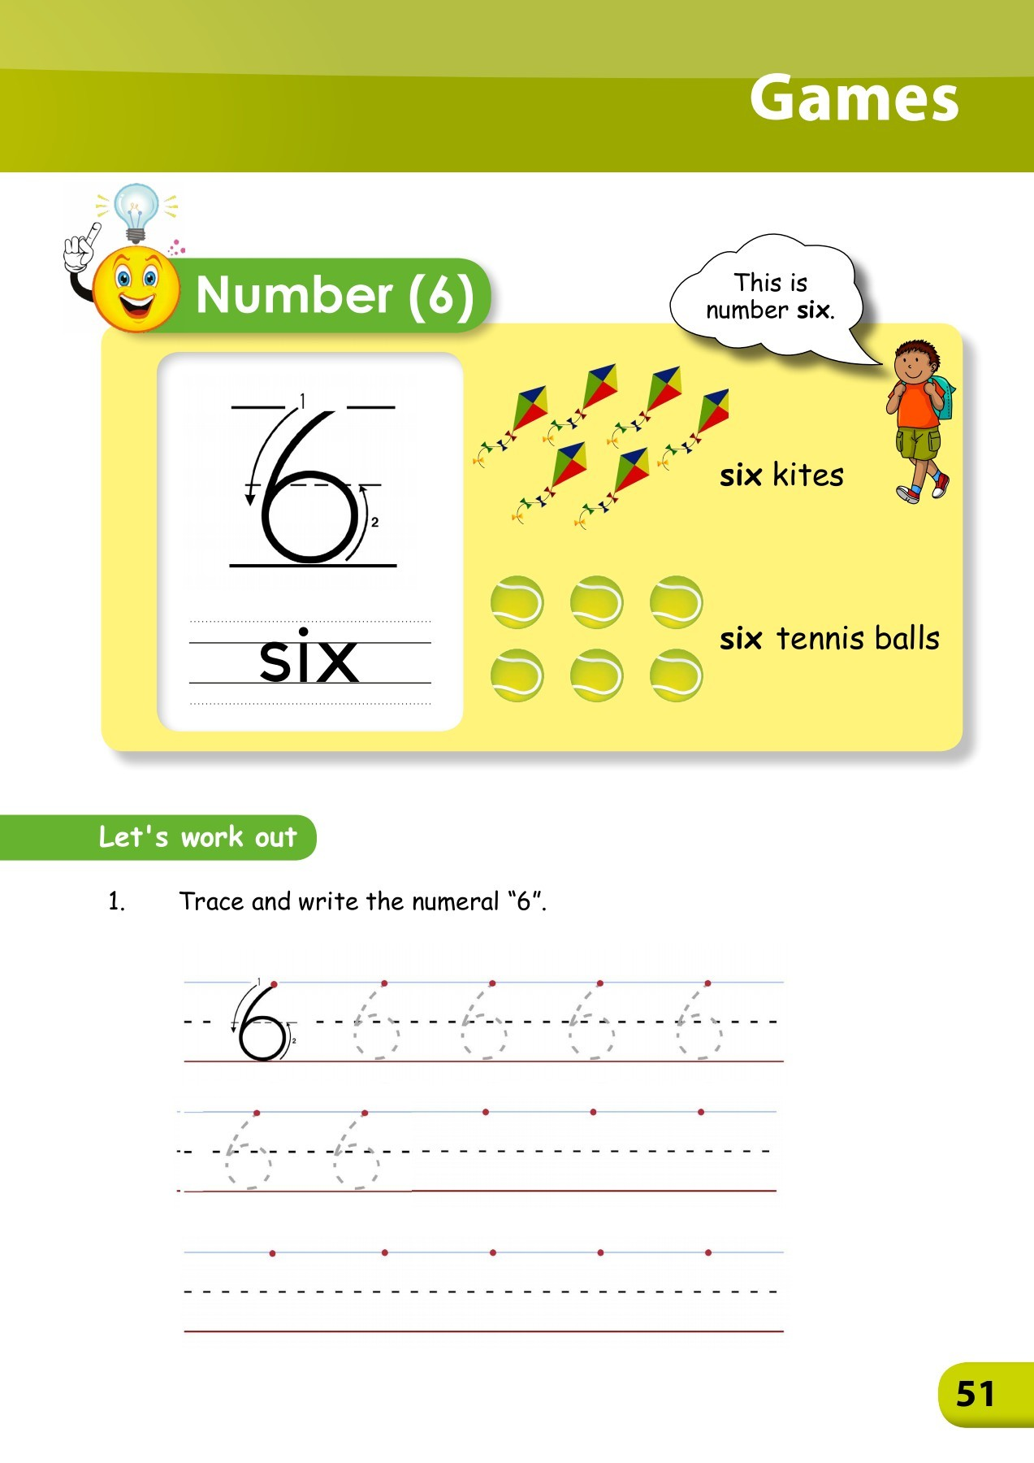
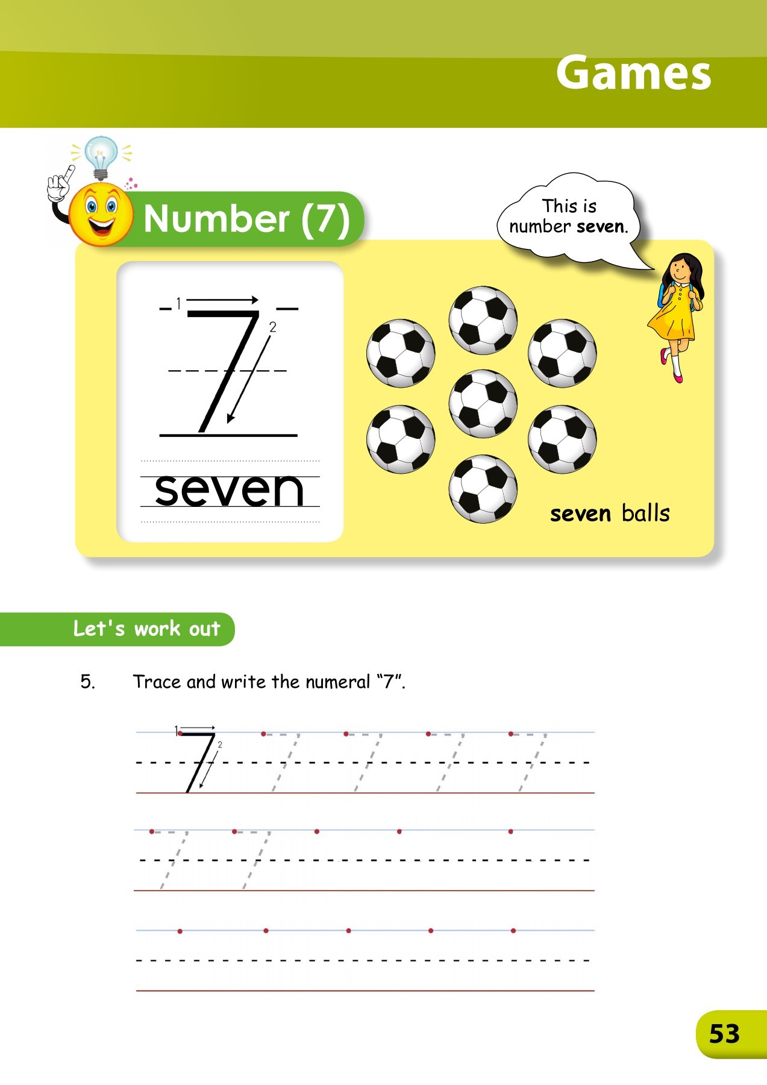
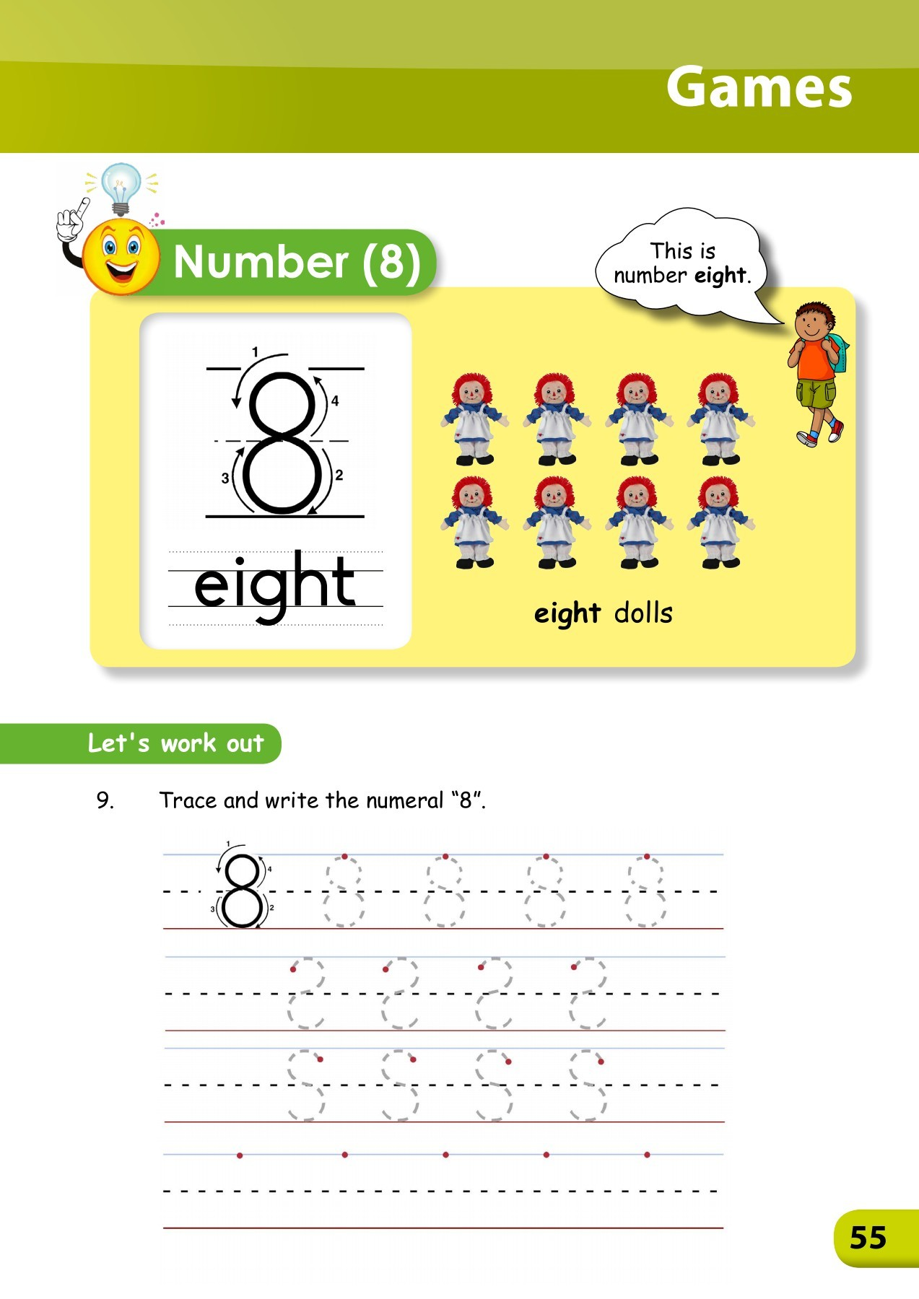
Number and number names
6 - six
7 - seven
8 - eight

Slide 4
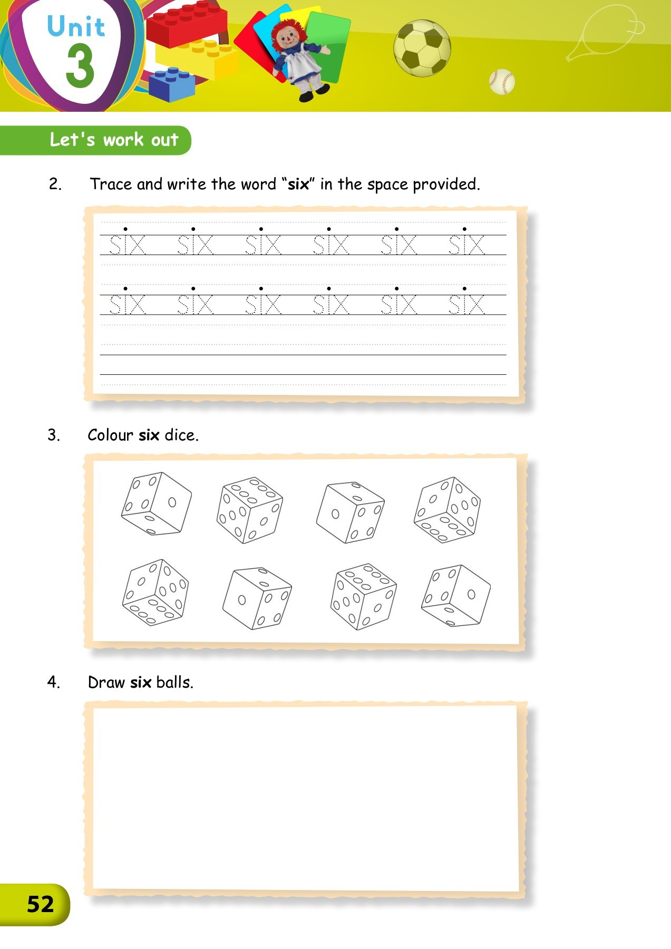
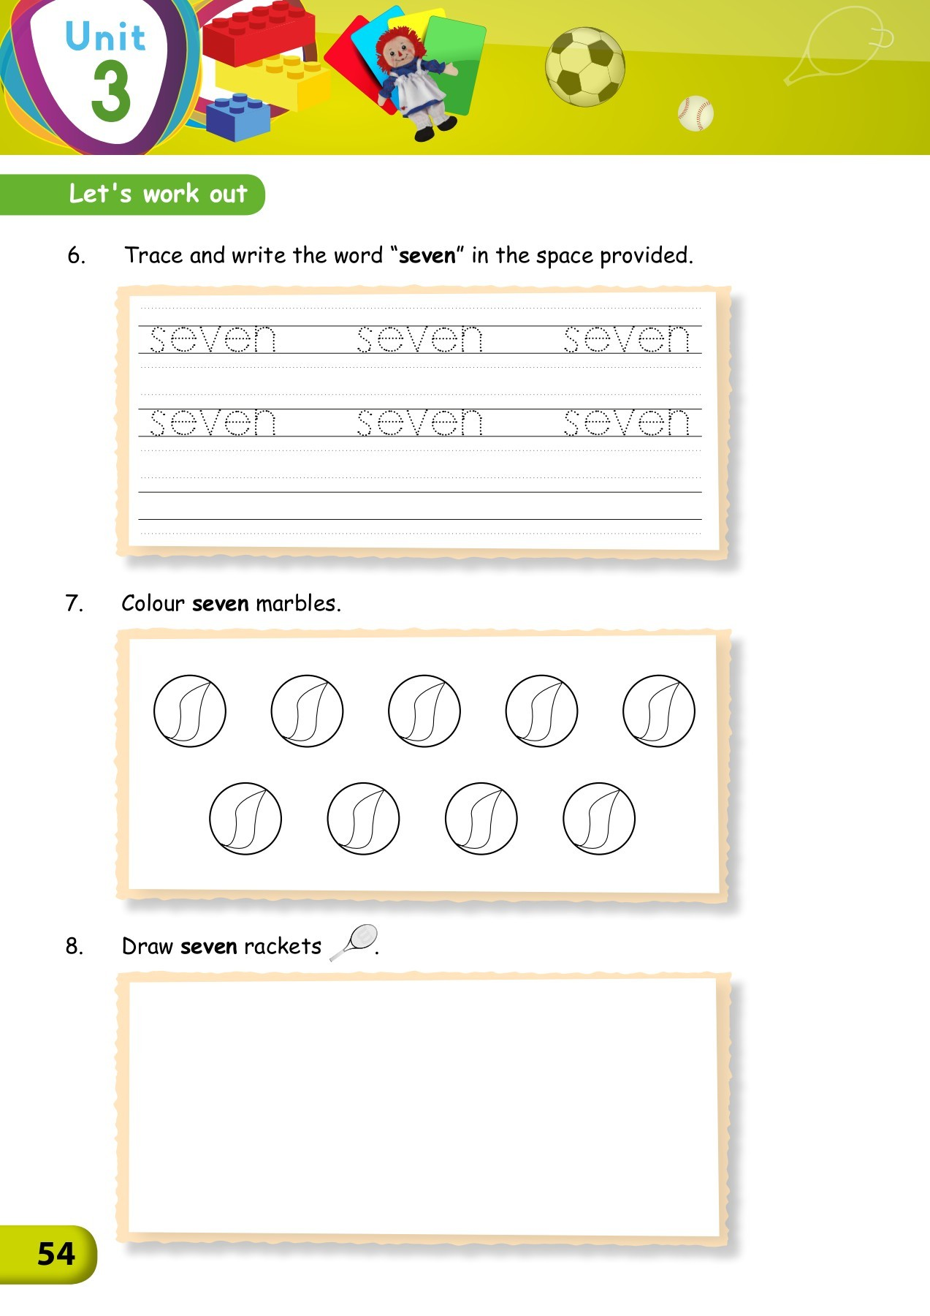
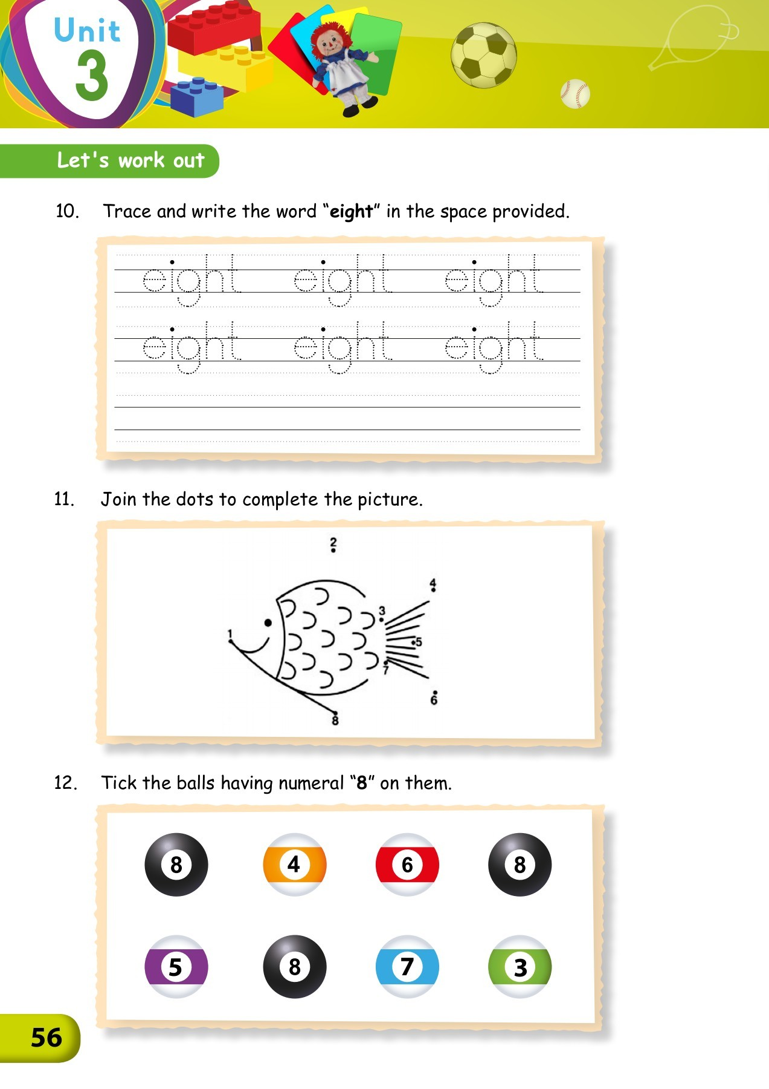
HOMEWORK Questions to be attempted are
Pg 52
Q 2 , 3 & 4
Pg 54
Q 5 , 7 & 8
Pg 56
Q 10, 11 & 12

