Slide 1


NORTHLANDS SCHOOL AND SUNFIELD CITY SCHOOL
PART 3
Word Processing – The Keyboard
Week 6
Presented by: Miss Neema ICT teacher

Slide 2
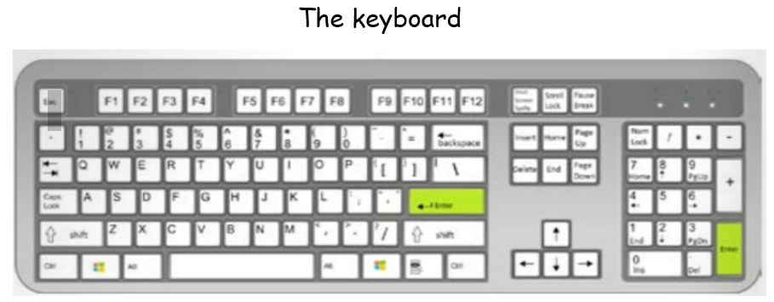
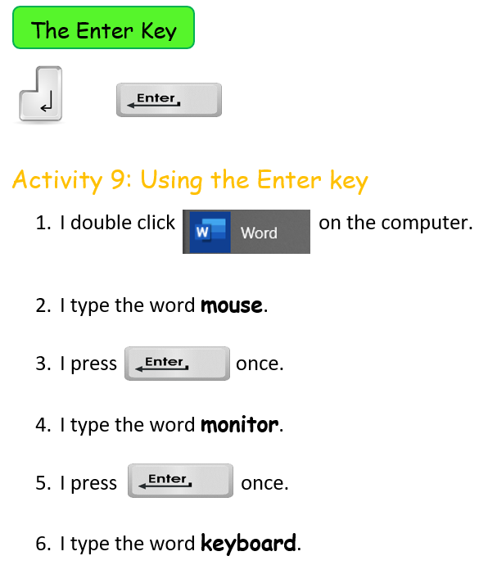
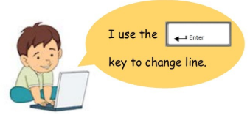

Slide 3
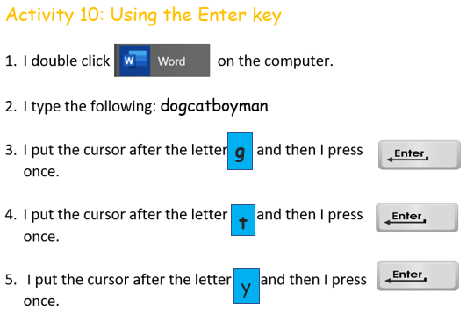

Slide 4
