Slide 1
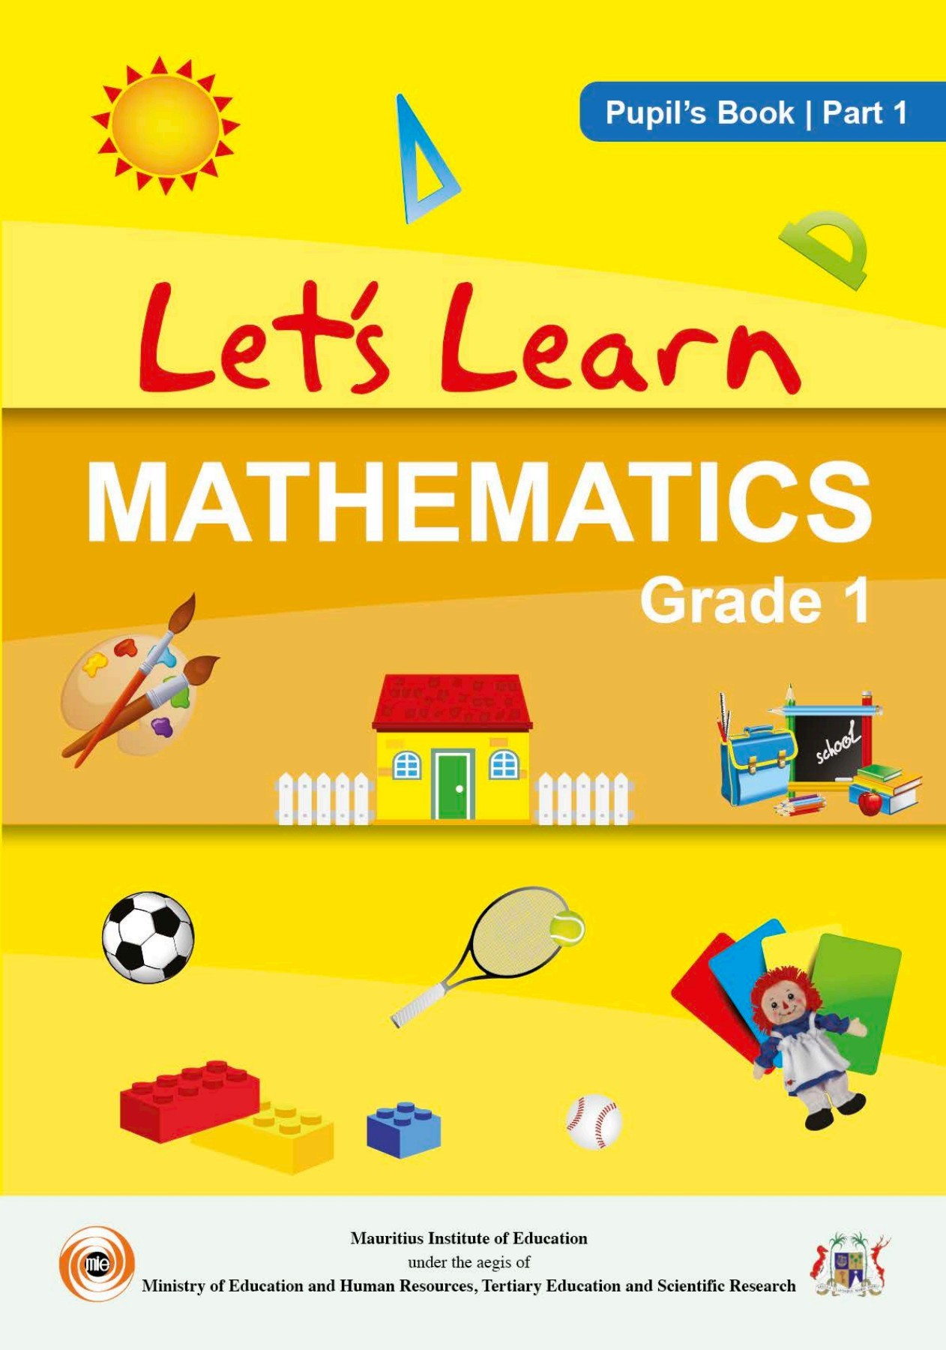

Northlands and Sunfield City School
Grade 1– Mathematics – TIME pg 40-43
Week 4 prepared by Miss Sweetie
OBJECTIVE:
Recognise and distinguish between ‘night’ and ‘day’.
Name the elements that characterize ‘night’ and ‘day’.
Read , write and spell the word ‘night’ and ‘day’.

Slide 2
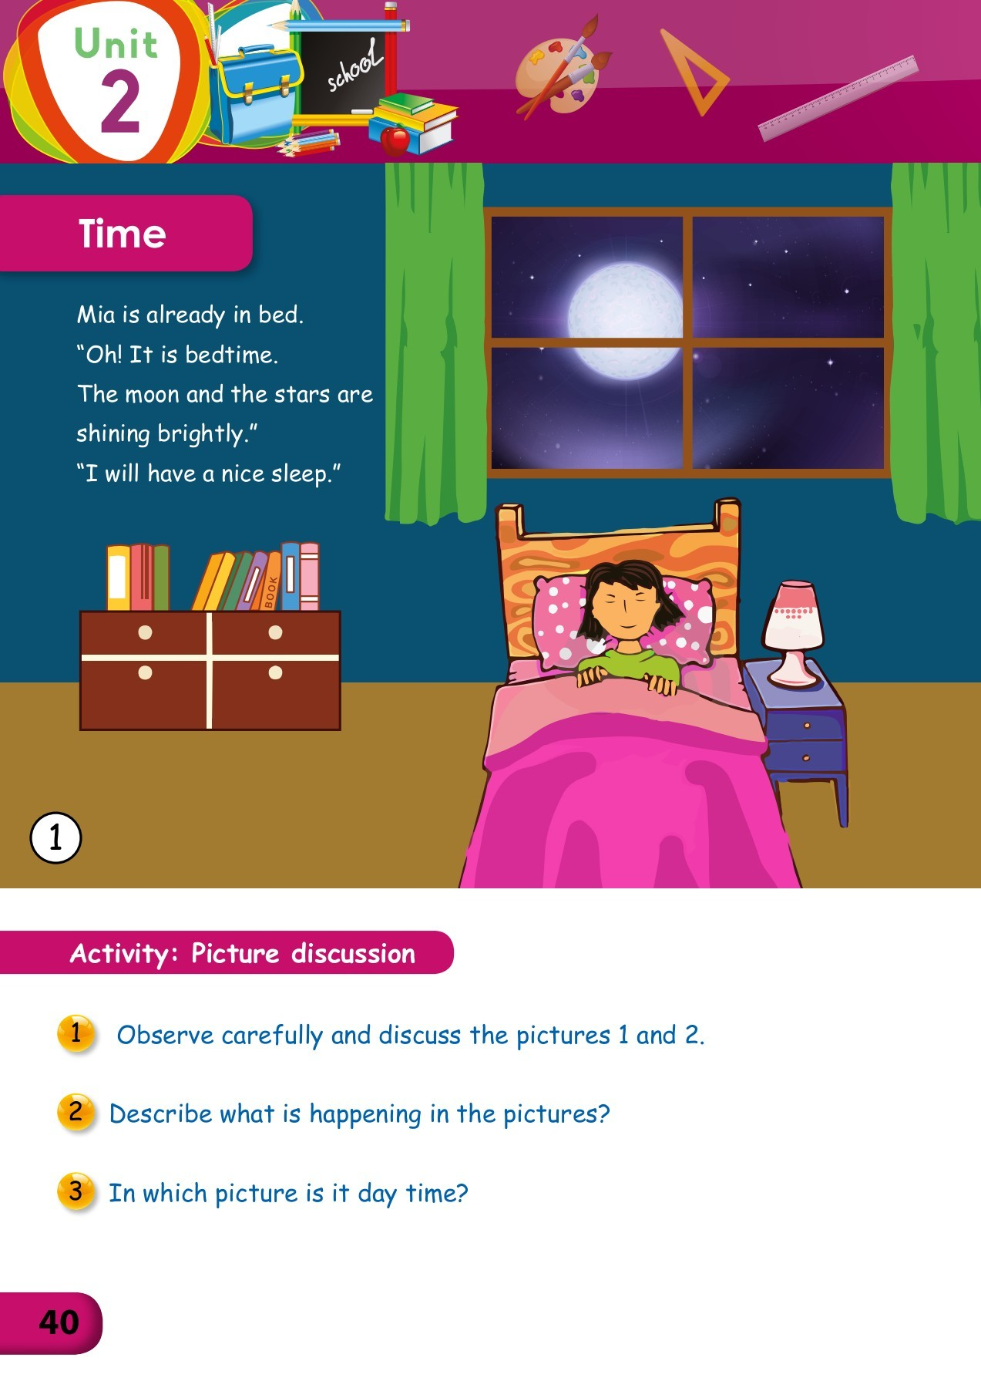
‘Night time’ picture discussion on page 40
At night we can see the moon and the stars shining brightly.
The sky is dark in colour.
The little girl Mia is sleeping in her bedroom.
Her bedroom objects are :- bed, pillow, bedcover, window, curtain, night lamp, drawer, books, bookshelf and blue colour wall.
The activities we do in the afternoon till night are:- have lunch, have snack, play with friends, have dinner , watch tv, read a book, complete the homeworks and finally we go to bed.

Slide 3
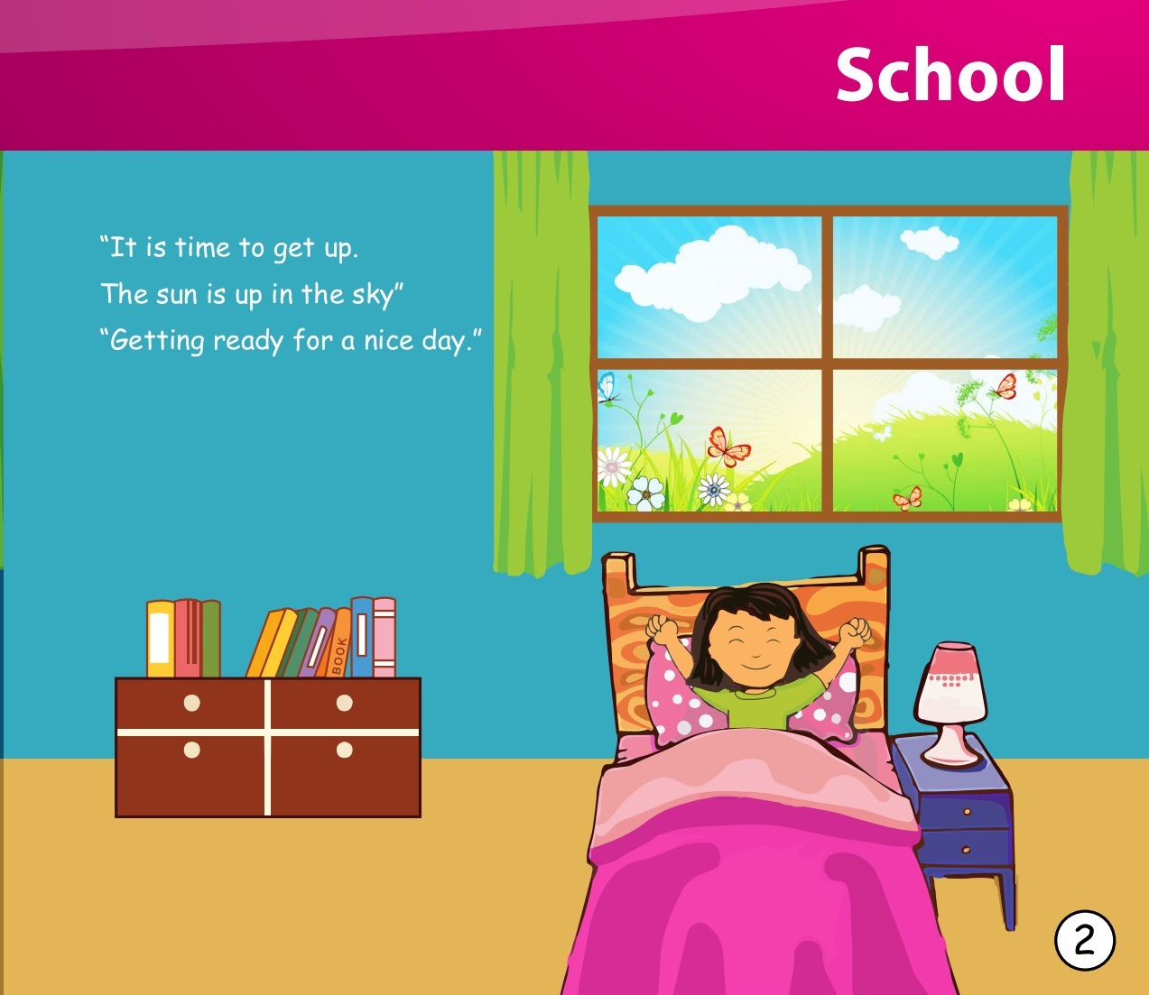
‘Day time’ picture discussion on page 41
During the day we can see the sun shining in the blue sky.
The little girl Mia is waking up and her bedroom is full of sunlight.
Flowers, butterfly, clouds and green grasses can be seen from her window.
Her bedroom objects are :- bed, pillow, bedcover, window, curtain, night lamp, drawer, books, bookshelf and blue colour wall.
The morning activities are :- wake up early, wash our hands & face, brush our teeth, take a bath and get dressed, comb our hair and have our breakfast.

Slide 4
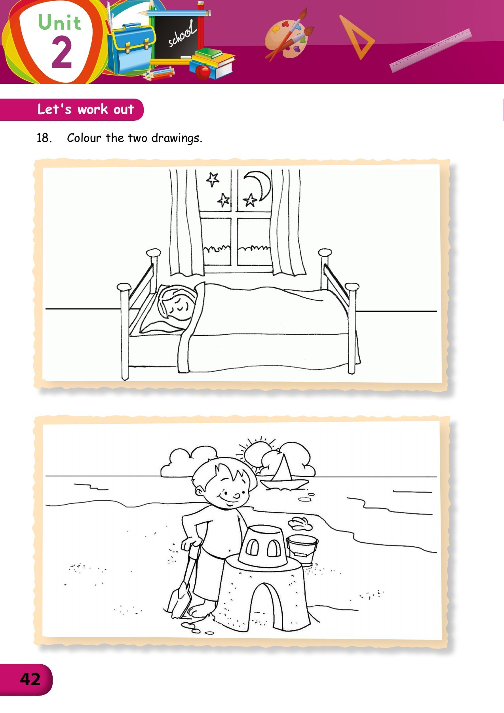
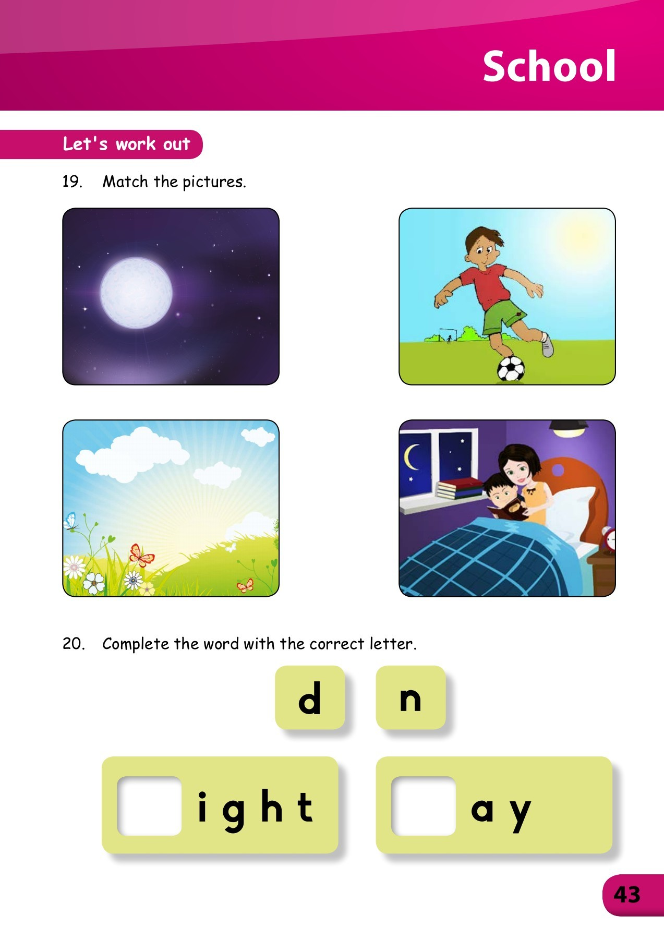
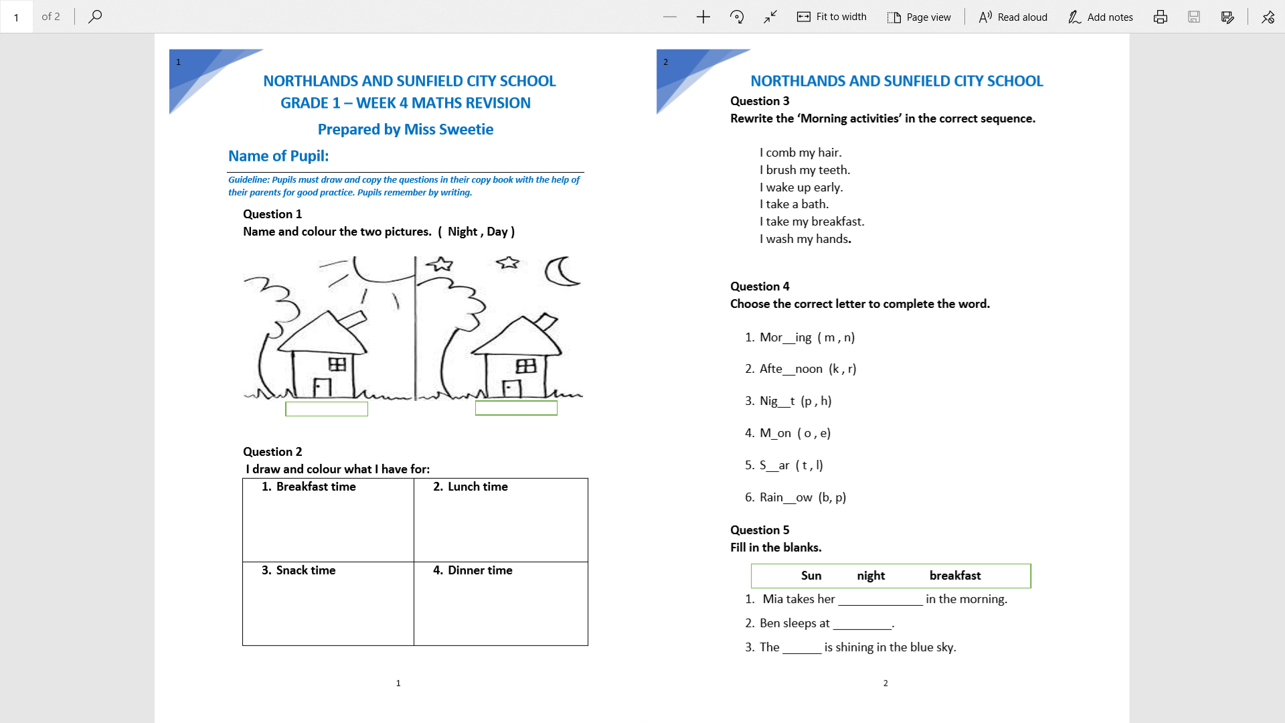
HOMEWORKs Questions to be attempted are:
Pg 42 Q18 and
Pg 43 Q19 & 20
Revision works
on ‘Time’

