Slide 1

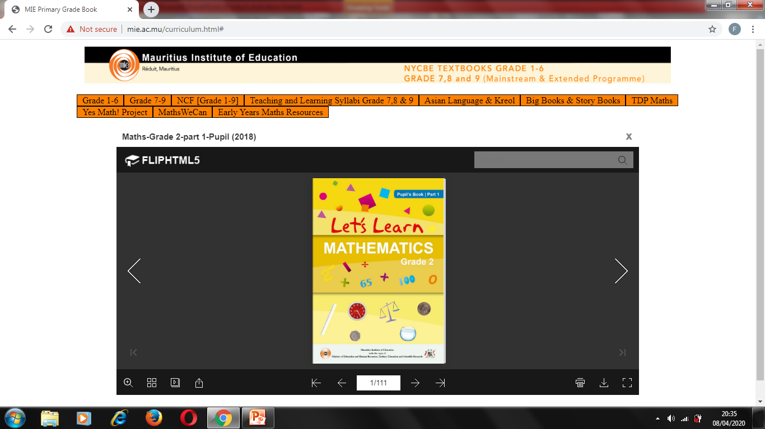
NORTHLANDS & SUNFIELD CITY SCHOOL
GRADE 2- MATHEMATICS
MASS
WEEK 4 (Prepared by Miss Mehreen)

Slide 2
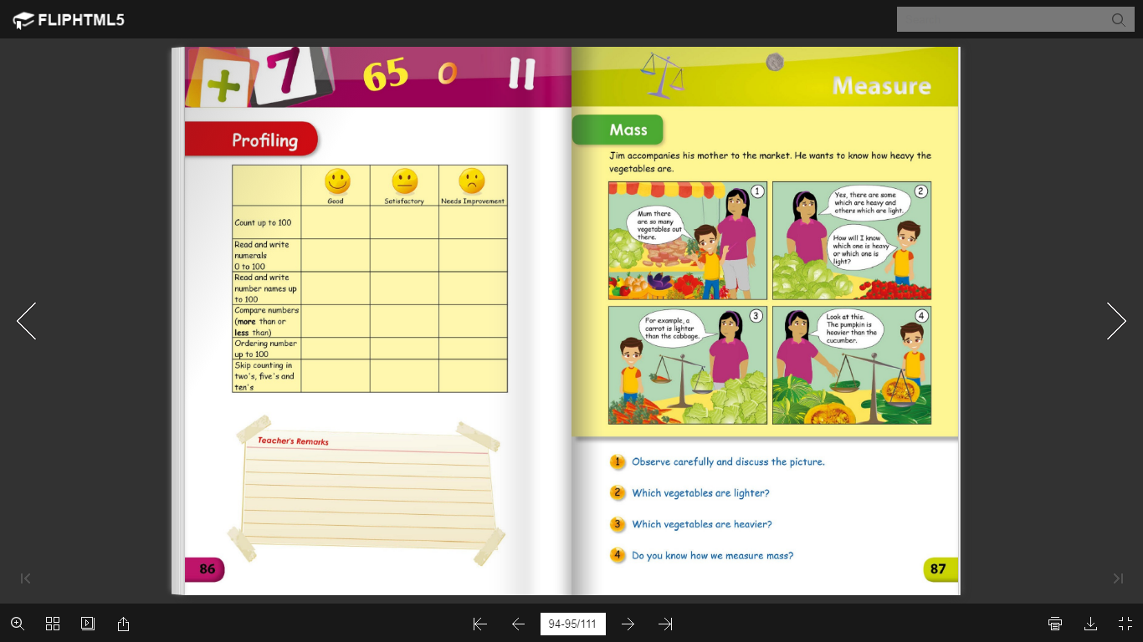
Notes:
https://www.youtube.com/watch?v=sVRhhmExdK0

Slide 3
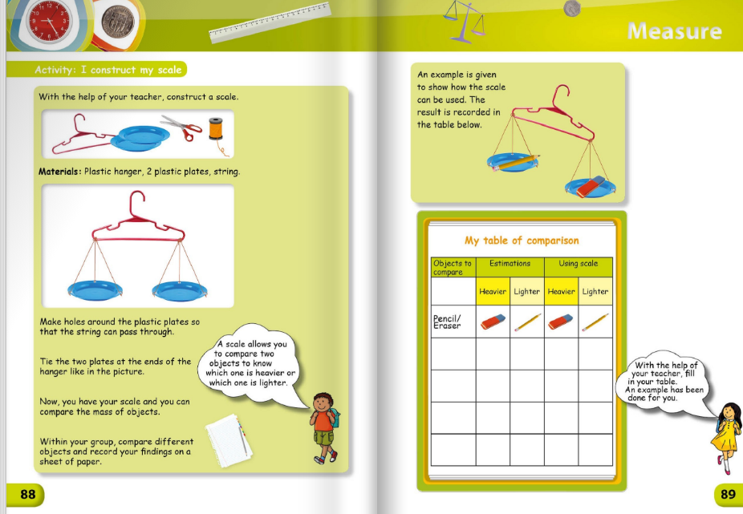
Notes:
https://www.youtube.com/watch?v=sVRhhmExdK0

