Slide 1

NORTHLANDS SCHOOL AND SUNFIELD CITY SCHOOL
PART 1
Word Processing – The Keyboard
Week 4
Presented by: Miss Neema ICT teacher

Slide 2
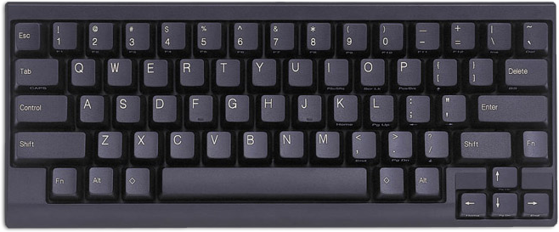

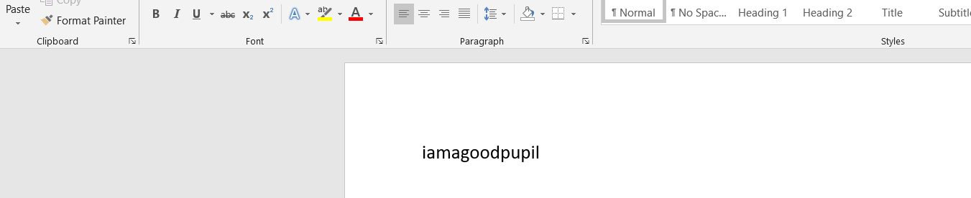

The Keyboard
Activity 3: Using the Spacebar Key
Spacebar
I double click on the computer.
I type the following: iamagoodpupil

Slide 3
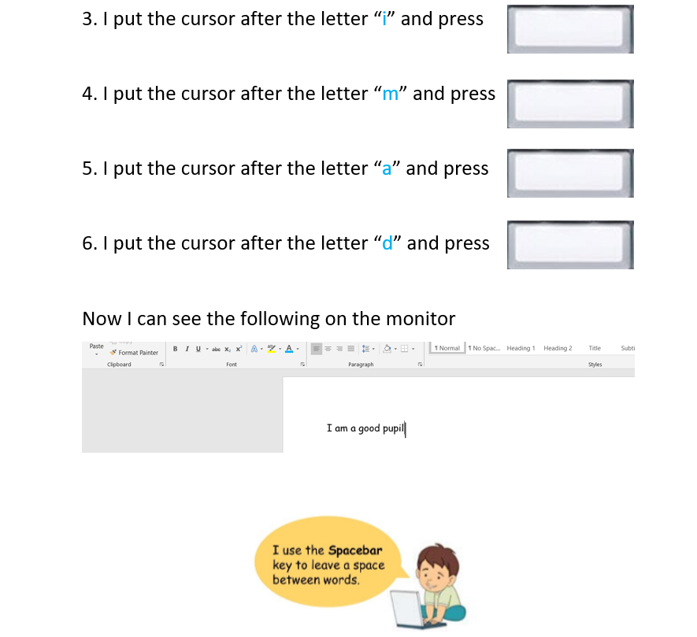

Slide 4
