Slide 1
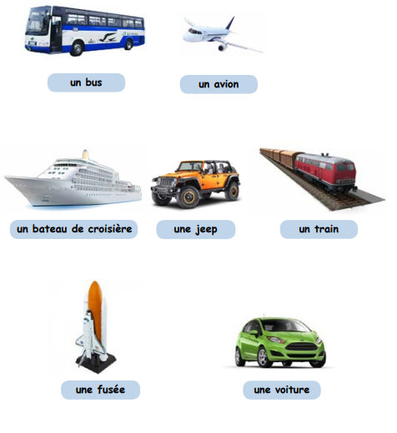

Northlands and Sunfield City School
Week 4 Grade 2 French
Part 1 Les voyages
Prepared by Miss Jennita (Pg 66)
Les Moyens de Transport

Slide 2
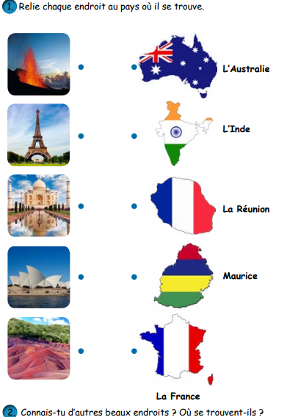
Quelques endroits (pg 67)

Slide 3

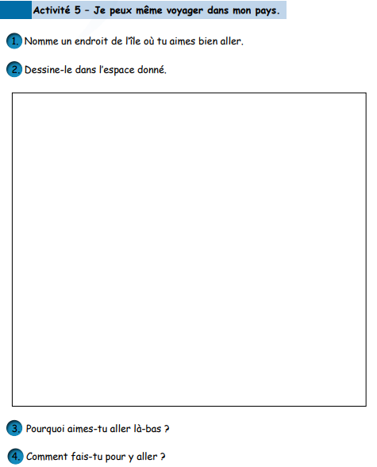
Mon pays (pg 68)

