Slide 1

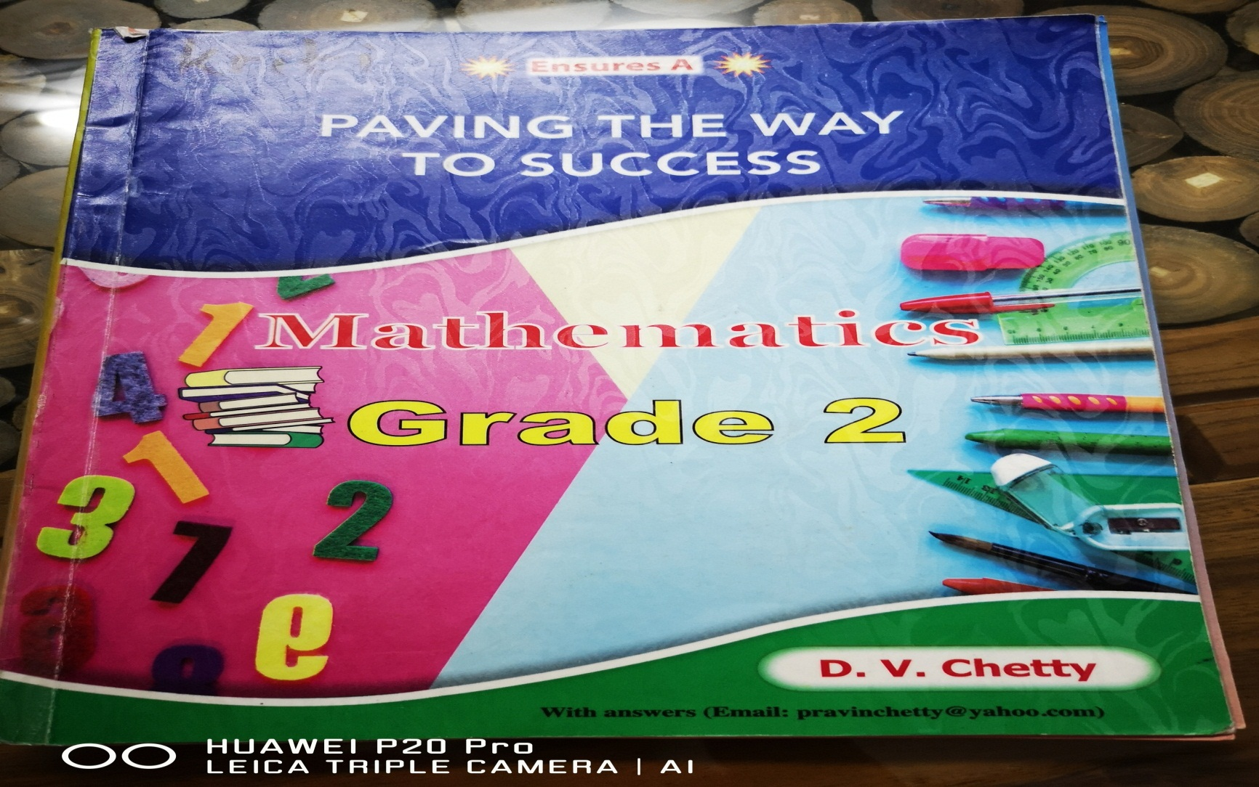
NORTHLANDS & SUNFIELD CITY SCHOOL
Grade 2 – 2nd term 2020
Mathematics
Prepared by Miss Mehreen

Slide 2
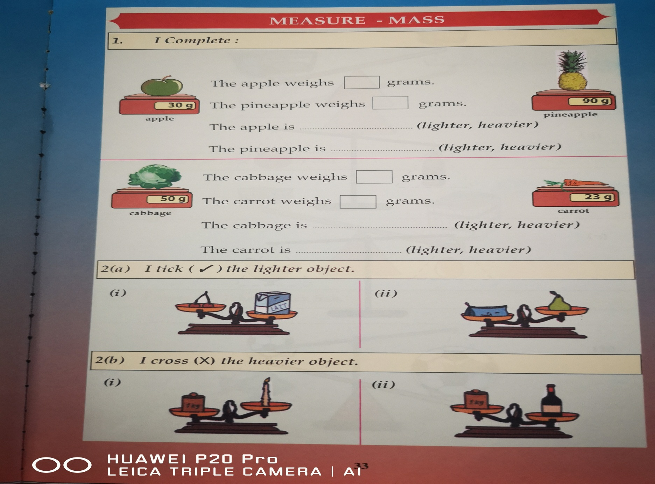
Page 33

Slide 3
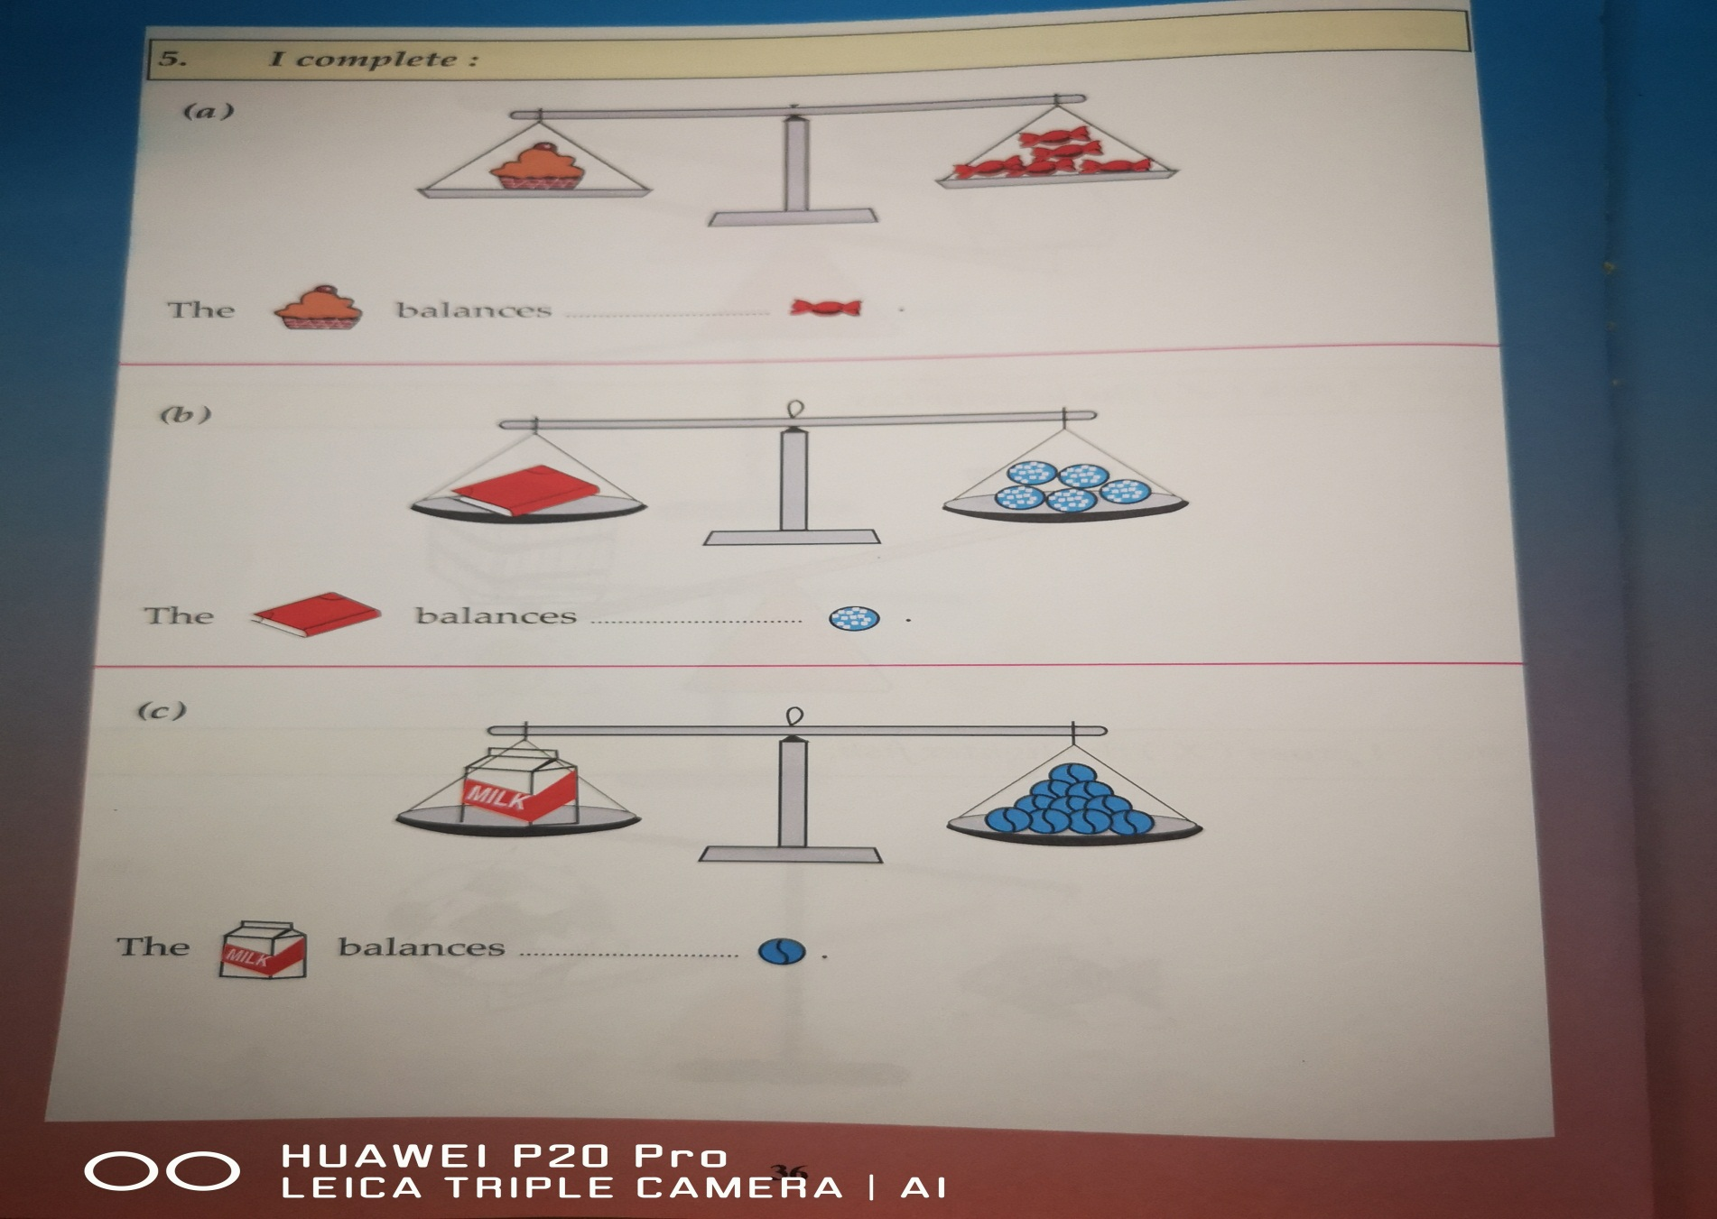
Page 36

