Slide 1

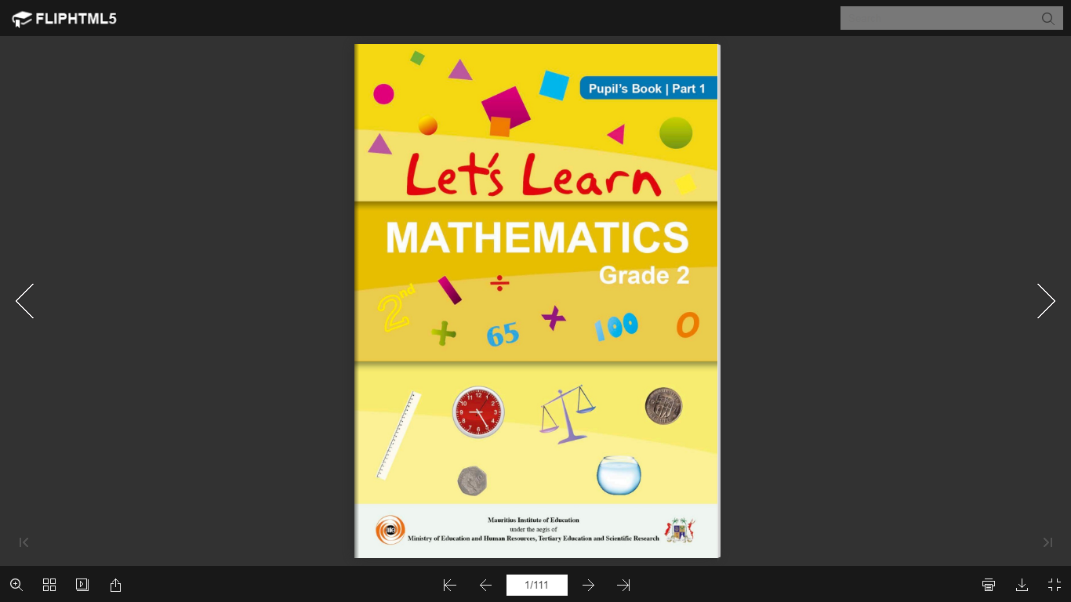
NORTHLANDS & SUNFIELD CITY SCHOOL
GRADE 2- MATHEMATICS
MASS
WEEK 5 (Prepared by Miss Mehreen)

Slide 2
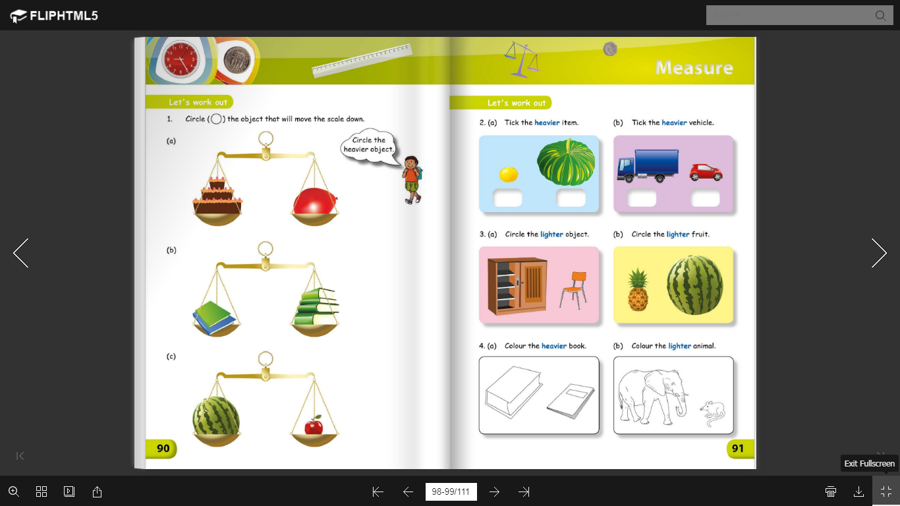

Slide 3
