Slide 1

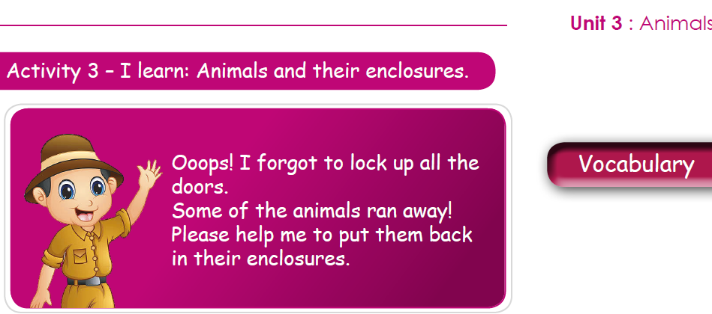

NORTHLANDS & SUNFIELD CITY SCHOOL
ENGLISH
Grade 2
Prepared by Ms Pareshma

Slide 2
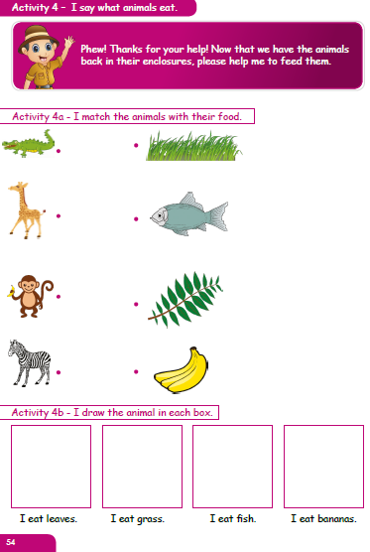
https://www.youtube.com/watch?v=k1izt2mVG-c&feature=youtu.be

Slide 3
