Slide 1


NORTHLANDS SCHOOL AND SUNFIELD CITY SCHOOL
PART 1 - Week 5
Spreadsheet
Page 40 - 42
Presented by: Miss Neema ICT teacher

Slide 2

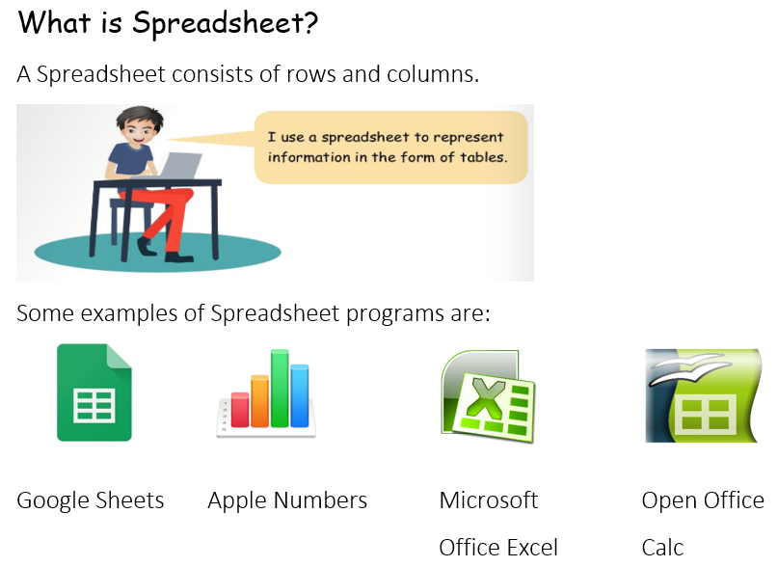
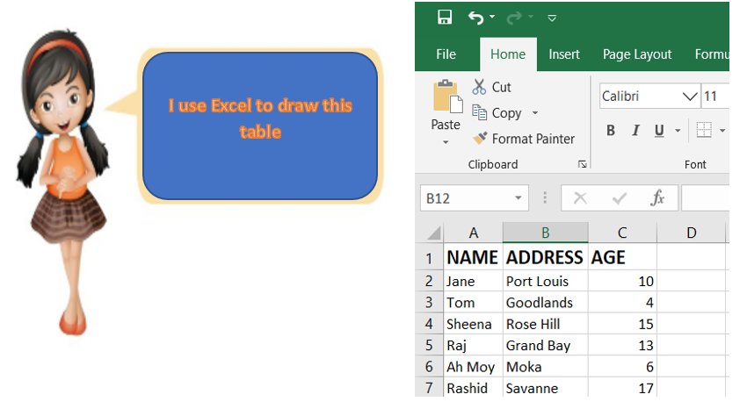
Unit 4:
Spreadsheet

Slide 3
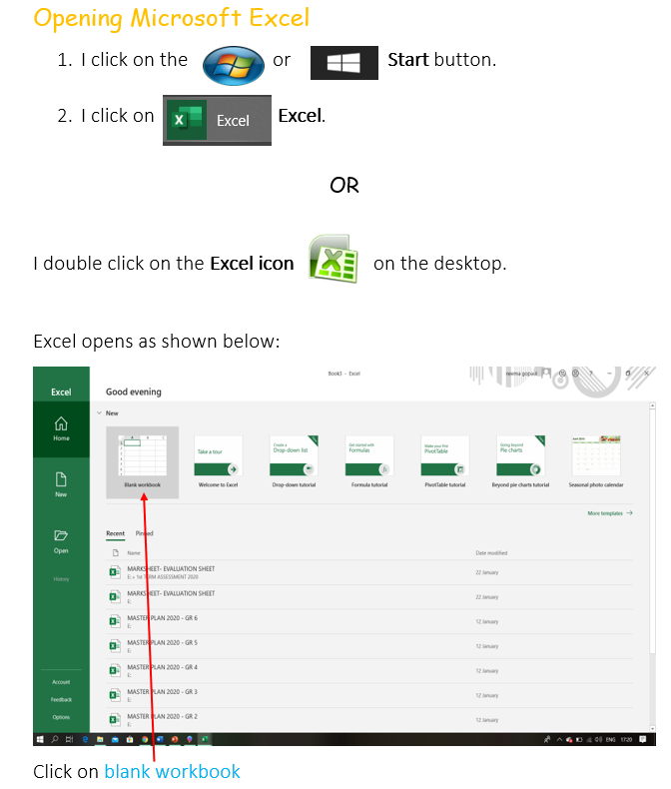
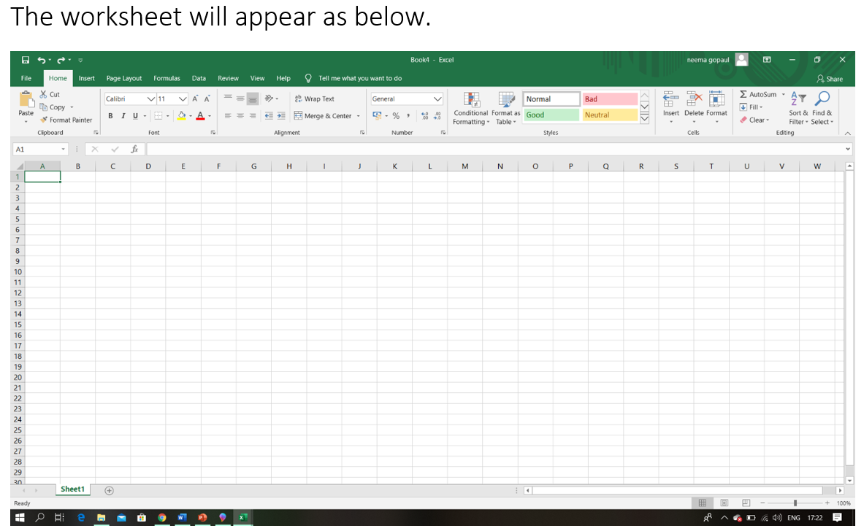

Slide 4
